Slide 1
IBM HACKATHON PROJECT
TRAVEL PLANNER AGENT
Presented By: PATHIKRIT PACHAL
Student name : PATHIKRIT PACHAL
College Name & Department : ACADEMY OF TECHNOLOGY – ECE.

Slide 2
OUTLINE
Problem Statement
Technology used
IBM Cloud services used
Wow factor
End users
Setting up
Agent Instructions
Quick Start Questions
Tools used & Testing
Deployment & Preview
API Reference After Deployment
Resources List
Results
Conclusion
Git-hub Link
Future scope
IBM Certifications

Slide 3
PROBLEM STATEMENT
Design and develop an AI-powered Travel Planner Agent that :
Designs travel plans tailored to individual choices and interests
Offers location suggestions and crafts complete day-by-day travel agendas
Provides options for transportation and lodging suited to the trip
Incorporates up-to-date information such as weather, routes, and local events
Handles reservations and keeps users informed with timely notifications
Adjusts itineraries on the fly to ensure efficiency and flexibility
Proposed Solution :
To tackle this problem, we propose developing an intelligent Travel Planner Agent using IBM Cloud Lite and IBM Granite. This AI-based assistant will interact with users via natural language, capturing details like their preferences, budget, travel period, and constraints. It will feature a conversational interface driven by IBM Watson Assistant, enhanced with IBM Granite to generate personalized and dynamic travel suggestions. The system will offer real-time, context-aware planning for destinations, transport, stays, and activities based on user input.

Slide 4
TECHNOLOGY USED
IBM cloud lite services
Natural Language Processing (NLP)
Large Language models (LLM)
IBM Granite model
IBM App Connect

Slide 5
IBM CLOUD SERVICES USED
IBM Cloud Watsonx AI Studio
IBM Cloud Watsonx AI runtime
IBM Cloud Functions
IBM Cloud service
IBM Granite (via watsonx.ai studio)
IBM Cloud Object Storage
IBM AI Tools

Slide 6
WOW FACTORS
The AI Travel Planner stands out with its ability to update travel plans in real time, adapting to changes like weather disruptions or transportation delays for a hassle-free experience. Leveraging the powerful capabilities of IBM Granite, the agent accurately interprets user input to generate deeply customized trip recommendations. It smartly suggests routes and destinations aligned with the traveler’s preferences, budget, and limitations. By seamlessly combining IBM Cloud services, the system delivers a smooth, conversational interface that transforms complex planning into a user-friendly interaction.
Unique features:
Dynamically adapts travel schedules in response to live weather conditions and transit updates.
Utilizes IBM Granite's language intelligence to interpret user queries and provide custom suggestions.
Delivers personalized options aligned with individual preferences, spending limits, and travel timelines.
Intelligently combines mapping services, weather forecasts, and booking data for cohesive trip planning.
Offers a conversational, chat-style interface powered by IBM Watson Assistant for smooth interaction.
Employs IBM Cloud Functions to run backend logic without managing servers, enhancing performance and scalability.

Slide 7
END USERS
Individual Travelers
Business Travelers
Travel Agencies & Consultants
Event Planners & Coordinators
Students or Researchers

Slide 8
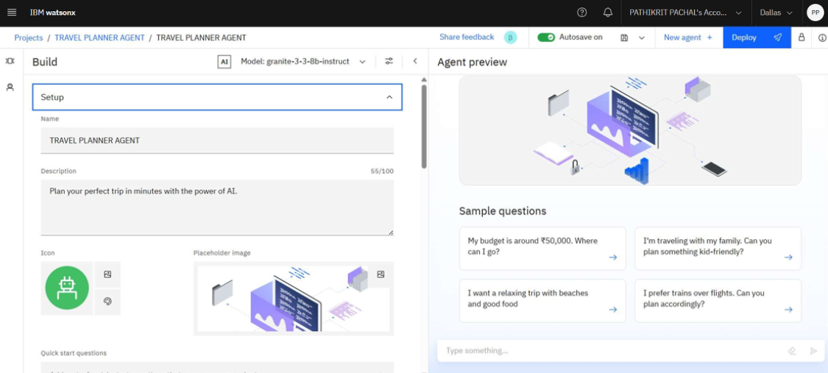
SETTING UP

Slide 9
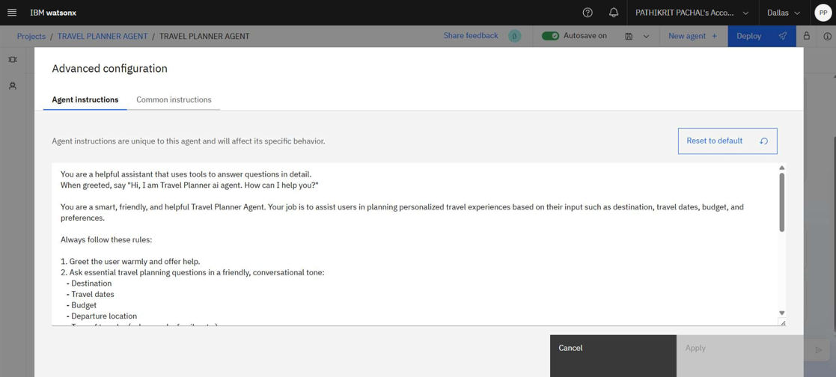
AGENT INSTRUCTIONS

Slide 10
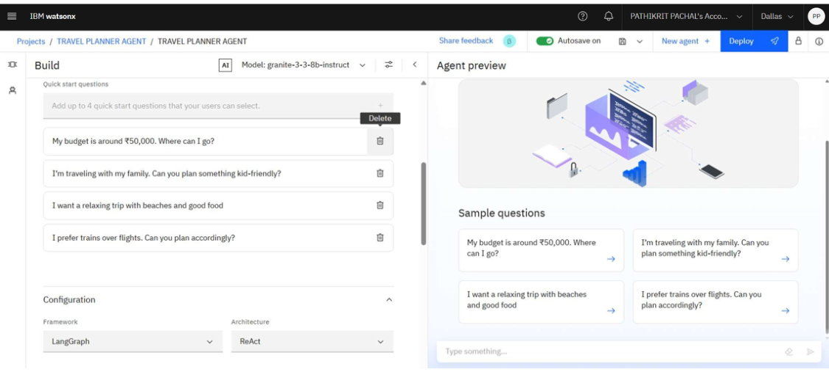
QUICK START QUESTIONS PREVIEW

Slide 11
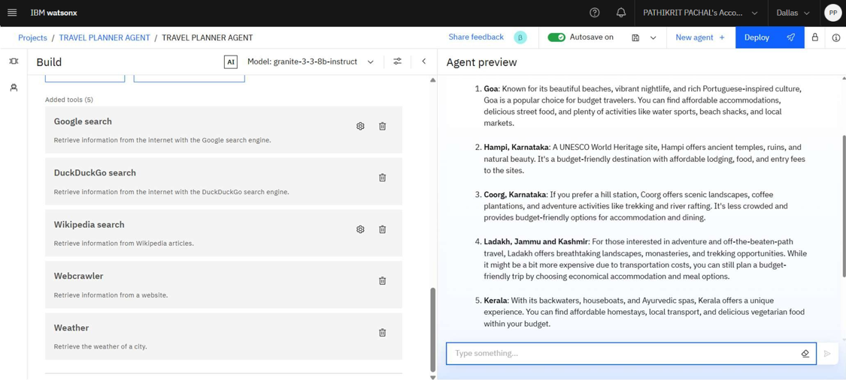
TOOLS USED & TESTING

Slide 12
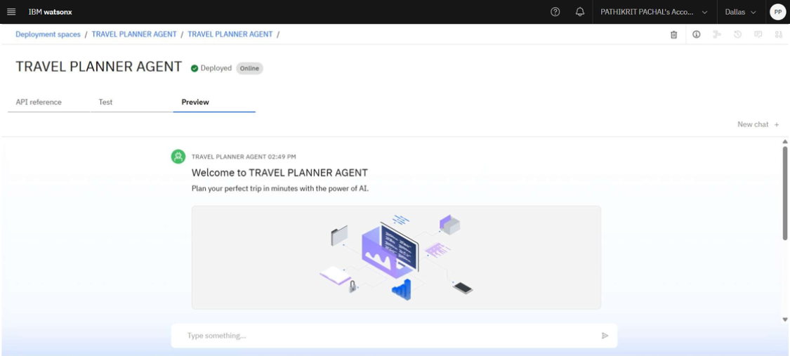
DEPLOYMENT & PREVIEW

Slide 13
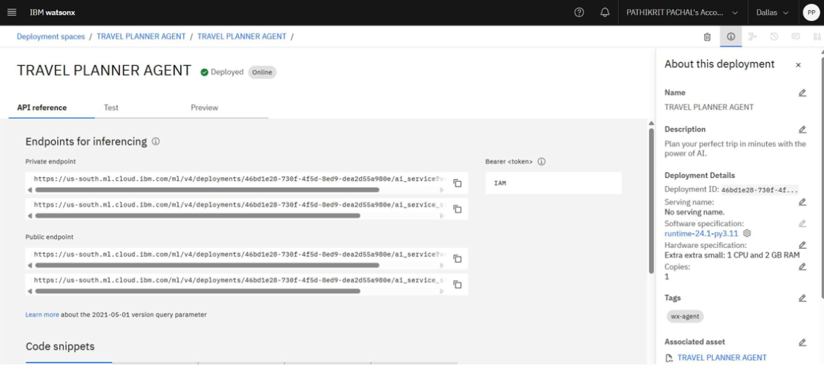
API REFERENCE AFTER DEPLOYMENT

Slide 14
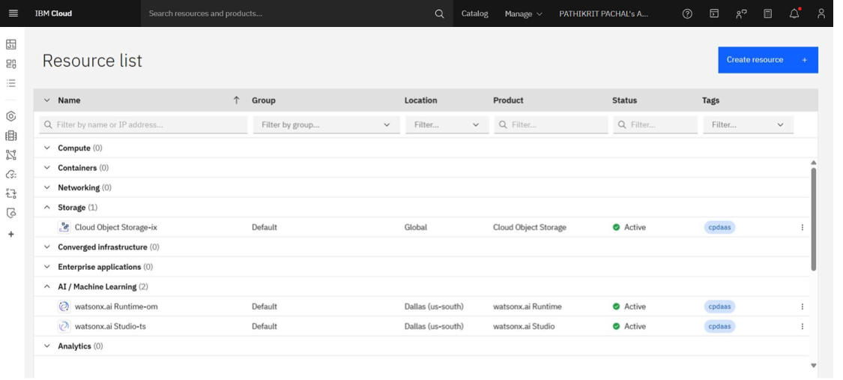
RESOURCES LIST

Slide 15
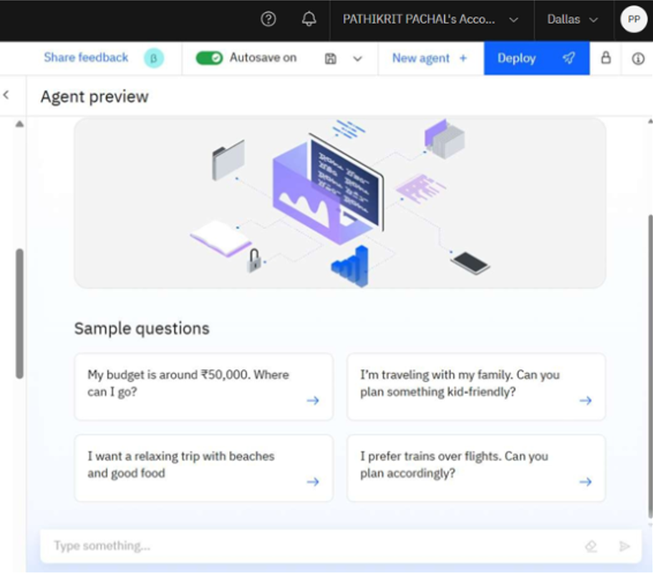
RESULTS

Slide 16
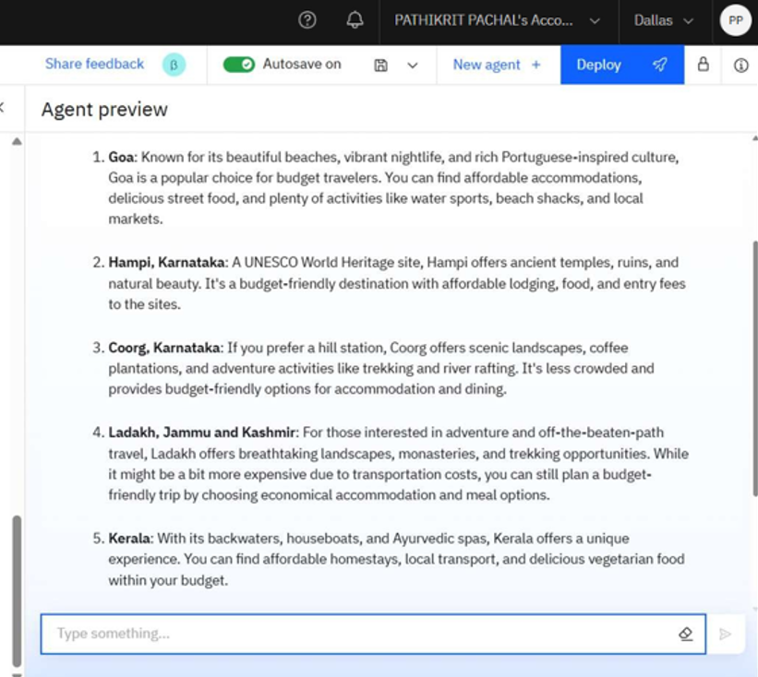
RESULTS

Slide 17
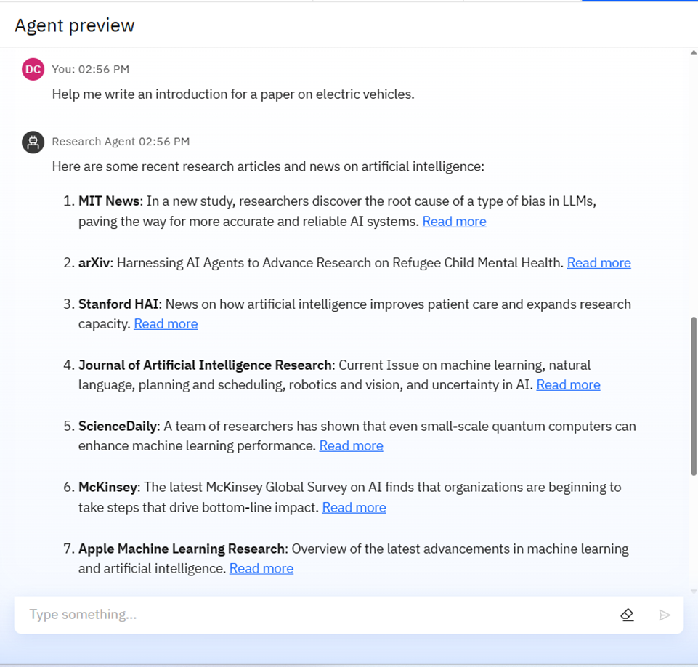
RESULTS

Slide 18
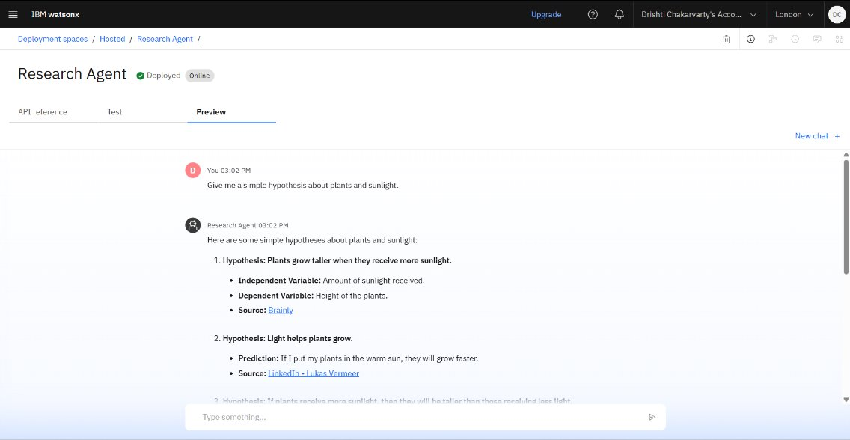
RESULTS
Deployed AI Agent

Slide 19
CONCLUSION
The AI Travel Planner simplifies the often over whelming task of organizing a trip.
By harnessing the capabilities of IBM Cloud’s AI tools, it provides users with smart, responsive, and customized travel assistance in real time.
This solution demonstrates how AI can be effectively applied to real-world travel logistics while maintaining a smooth and user-centric experience.

Slide 20
GITHUB LINK
https://github.com/Pathikrit007

Slide 21
FUTURE SCOPE
Compatibility with voice-controlled devices like Alexa and Siri for hands-free interaction.
Support for multiple languages using Watson Language Translator to assist global travelers.
Seamless connection to travel booking sites such as Skyscanner and Airbnb for real-time reservations
Built-in emergency response tools that offer help based on user location and alerts
Functionality in offline mode to support travel in areas with poor internet access
Augmented Reality previews that let users explore destinations virtually before visiting
Intelligent budget planning tool that maximizes travel quality within financial limits.

Slide 22
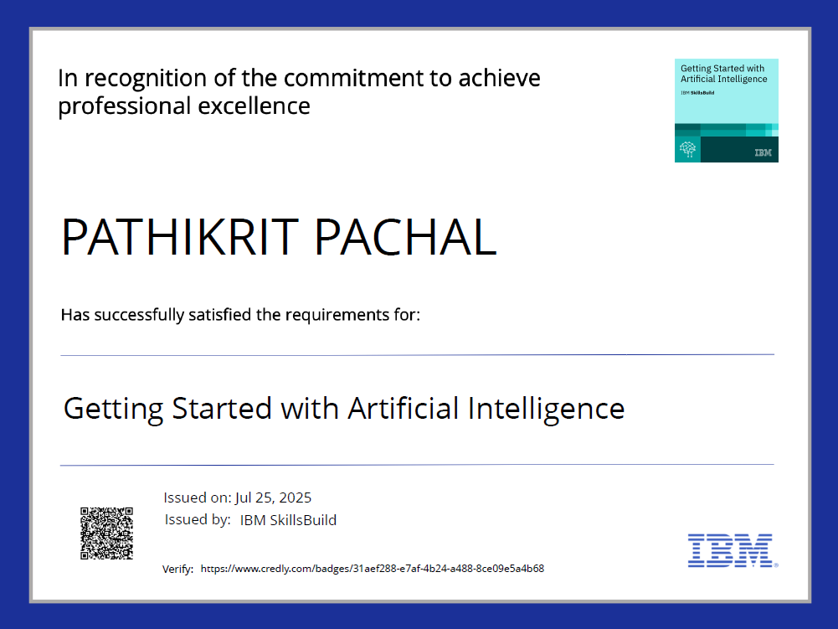
IBM CERTIFICATIONS

Slide 23
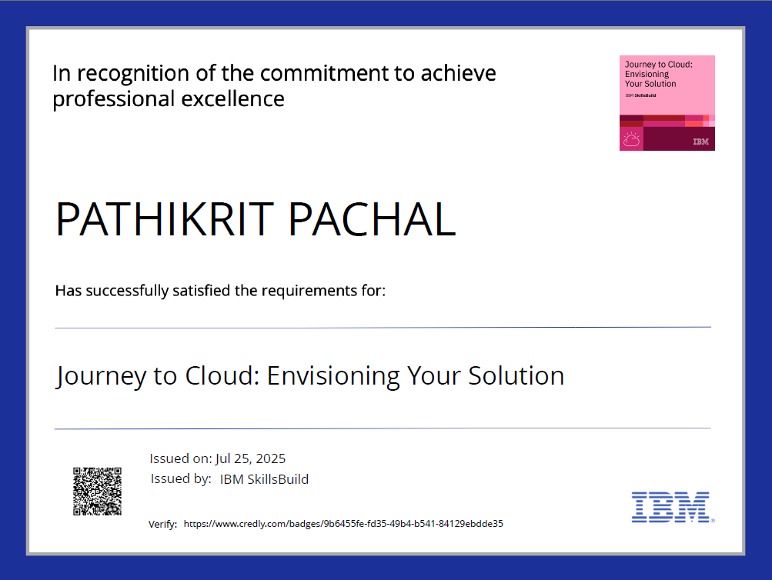
IBM CERTIFICATIONS

Slide 24
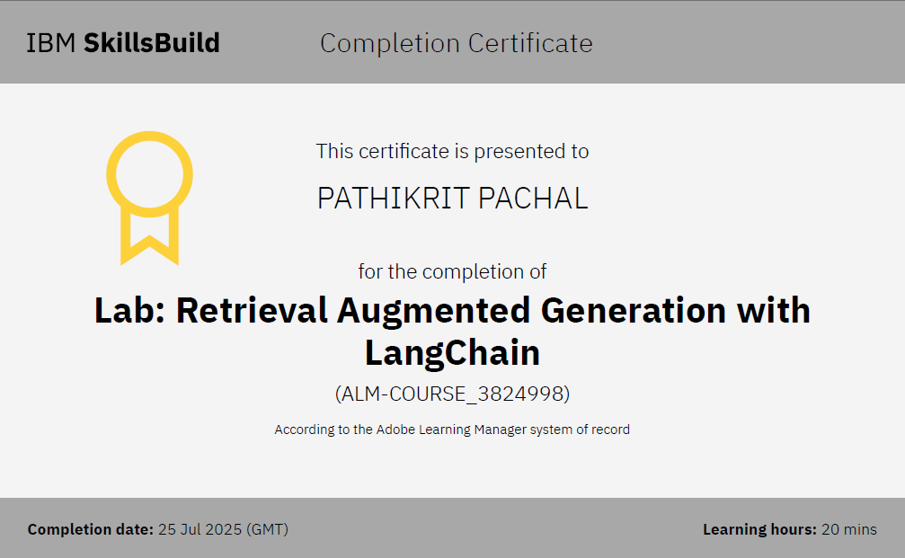
IBM LAB CERTIFICATE

Slide 25
THANK YOU

